Slide 1
1

Slide 2
Illicit Massage Establishments
Proposed Ordinance Amendments
Minal Patel Davis, Special Advisor to the Mayor on Human Trafficking
with Children at Risk Representative
2

Slide 3
Role Overview
Appointed as Special Advisor to the Mayor on Human Trafficking on
June 29, 2015
Role includes coordinating services, managing the affairs of the Mayor’s Houston Area Council on Human Trafficking, increasing awareness
I was the volunteer chair of this Council/Task Force for 6 months prior to being appointed
Examining ordinances and making recommendations that set a
different tone in our city
3

Slide 4
Outline
Overview on Human Trafficking and reasons for change
National and Local Information on Illicit Massage Businesses (IMBs)
Local IMB Advertisements and Scope
Dallas and San Antonio Ordinances, district breakdowns
Discuss proposed changes to Chapter 28, Misc. Offenses and Provisions, Article XII. Massage Establishments
Benefits and Costs
Timeline and Stakeholders
4

Slide 5
Human Trafficking Definitions
Human Trafficking occurs when a trafficker uses force, fraud or coercion to control another person for the purpose of engaging in commercial sex acts or soliciting labor or services against his or her will
No force fraud or coercion is required if the person engaged in a
commercial sex act is under 18 years old
The crime despite its name does not require movement
Some examples are street or web based, pimp controlled prostitution
Relevant manifestation for today are the IMBs that are sometimes fronts for Human Trafficking
5

Slide 6
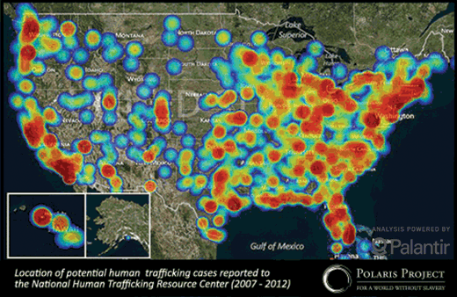
Polaris Project - National Hotline calls
➢
6

Slide 7
National IMB Estimates
Polaris has experience serving women from IMBs, has reviewed law enforcement reports, service provider reports, public records, and media accounts
Polaris estimates that 1 IMB on average has 3 women who average 4 customers a day, each customer pays the average house fee of
$60
With an estimated 9,000 IMBs based on sex buyer review boards, they generate an estimated $6,000,000 a day
7

Slide 8
Purpose
In order to help combat human trafficking in the City of Houston, City
Council is asked to amend Chapter 28 of the code of ordinances
IMBs often help to facilitate the illegal sex trade, human trafficking and pose a particular threat to the safety, health and wellbeing of Houstonians
Recent research shows that Houston is home to more active IMBs than any other city in Texas
The latest search conducted on 9/14/2015 showed 240 IMBs offering services online out of a running list of 387 places because the IMBs open and close
8

Slide 9
Purpose
On the same day, the list of 240 IMBs was crossed with a list of state licensed establishments, only 9 of the establishments that advertised suggestive services on the internet had a state license
The current ordinance only authorizes law enforcement to conduct
inspections at state licensed massage establishments
The proposed ordinance changes will allow law enforcement to inspect businesses that have a state license, but also those that advertise massages and should have a state license
It will also recognize that law enforcement action and access is required to assist in closing these parlors while balancing legitimate business owners' interests
9

Slide 10
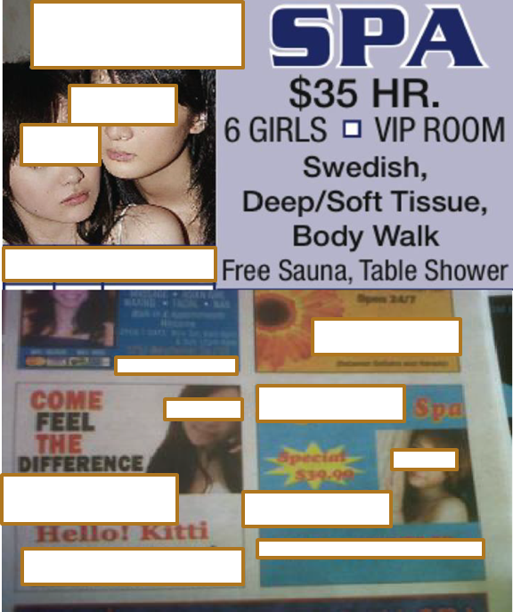
Illicit Spas/Massage Parlors
Open at odd hours, legal hours of operation are from 8 AM -10 PM
Unusual suggestive names
Barred Windows
Cameras
Asian Populations
Commercial Sex with 4-5 men per
day
10

Slide 11
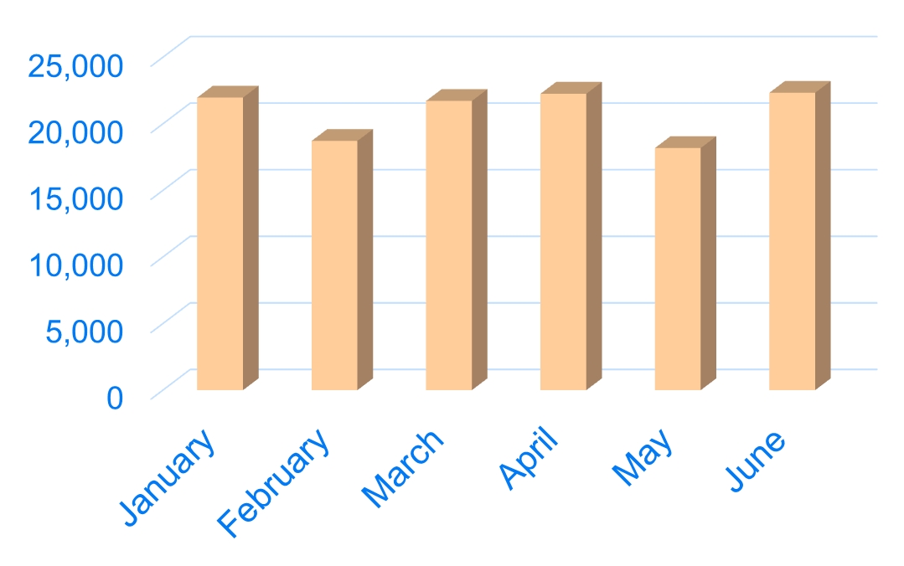
Volume of Paid Sex Ads in Houston
11

Slide 12
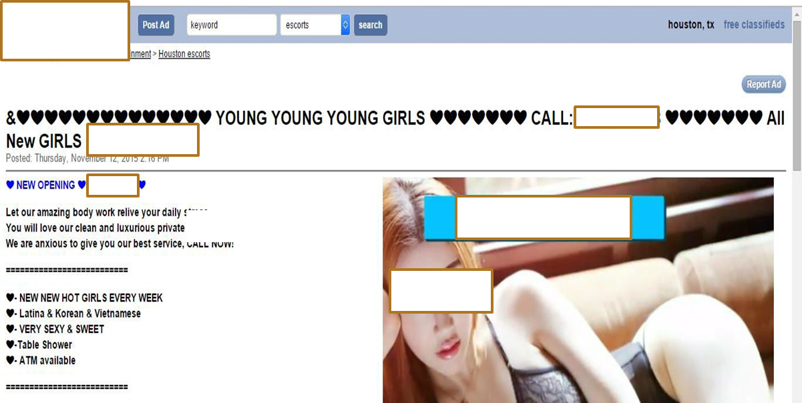
Online Massage Ads
12

Slide 13
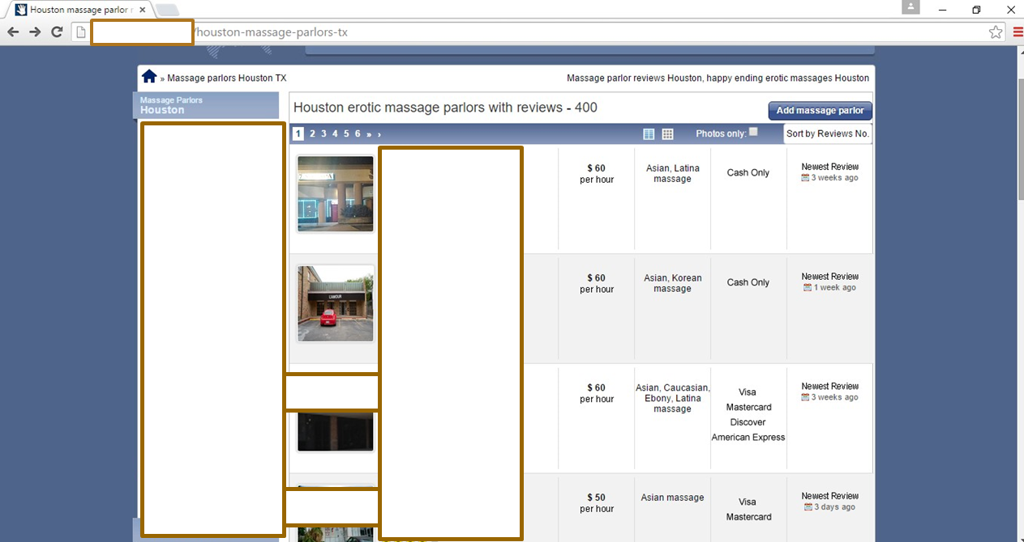
Buyer Reviews
13

Slide 14
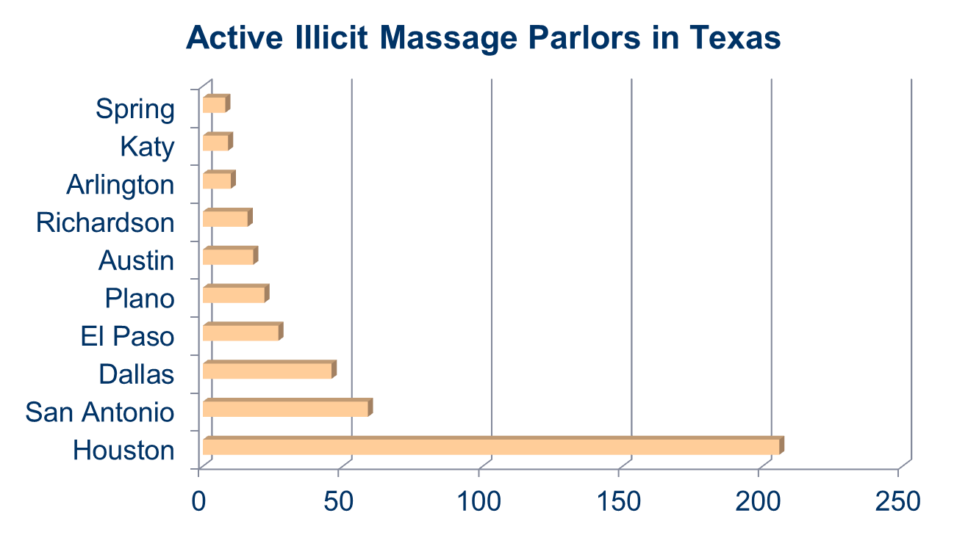
How Does Houston Compare?
Source: Polaris Project; (2014)
14

Slide 15
Ordinance Comparison
Dallas – Local permit required and a $200 permit fee for each establishment; inspector may inspect for health and safety reasons. If they have probable cause to enter, entry is denied, they make application for a search warrant
San Antonio – Local permit required, $75 annual fee, and
ordinance declares all massage establishments public places
City of Houston - No recommendation of permitting, expanding definition of Massage Establishment to include those that advertise using massage and to incorporate access language at the local level
15
15

Slide 16
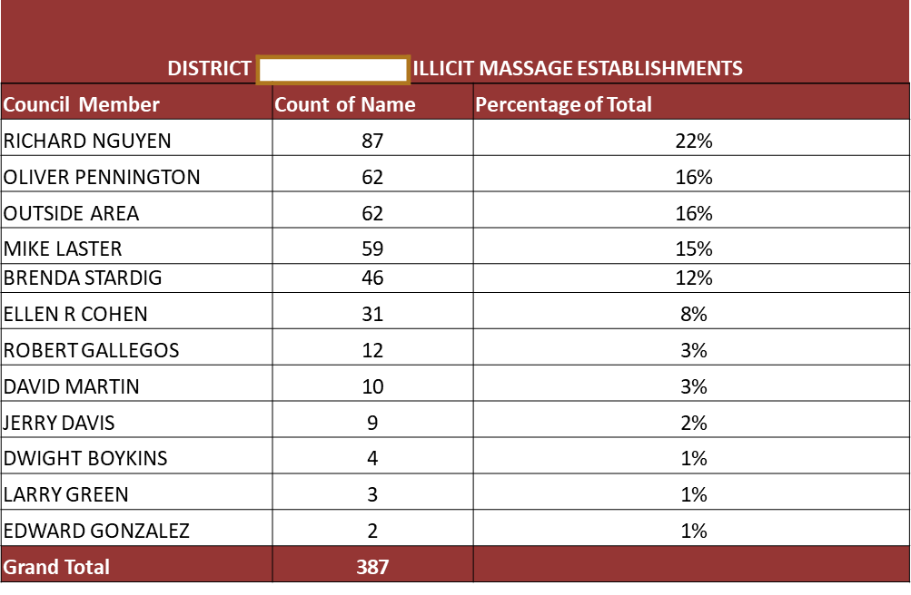
District Counts
RUBMAPS.COM
16

Slide 17
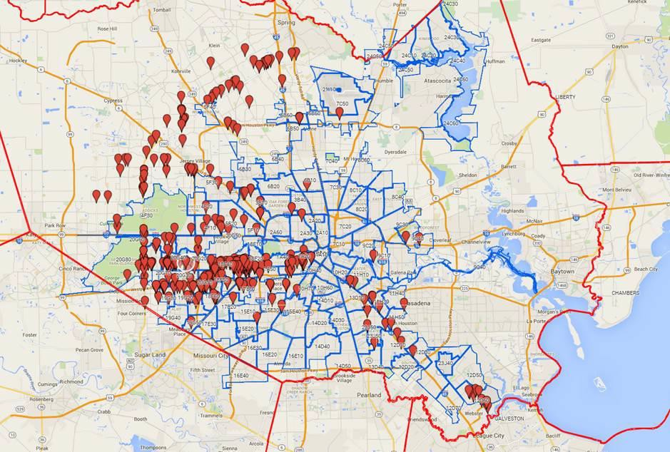
Illicit Massage Businesses
17

Slide 18
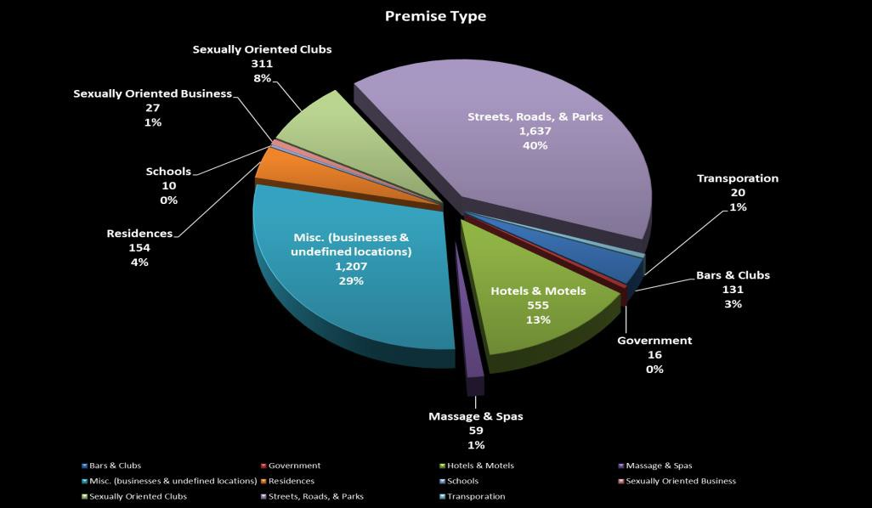
Human Trafficking & Prostitution-Related Incidents by Premise Type
2-year total: 4,127
Note: “Government” indicates locations such as police stations and hospitals. Addresses are sometimes used to generate reports while investigations are ongoing. Source: HPD Crime Database
Extracted 11/17/2015 –for time period Nov. 17, 2013 – Nov. 17, 2015)
18

Slide 19
Proposed Changes Sec. 28-361. Definitions.
Massage establishment means any building, room, place, or any establishment whose business includes advertising or offering a massage or other massage services, other than a regularly licensed hospital, medical clinic, or licensed physical therapy treatment facility where massage is practiced upon the human body for compensation by any person not a duly licensed physician or chiropractor, whether with or without the use of mechanical, therapeutic or bathing devices, and shall include Turkish bathhouses. This term shall not include beauty parlors or barbershops duly licensed by the state, or licensed hospitals, medical clinics, however, beauty parlors or barbershops duly licensed by the state, or licensed physical therapy facilities or establishments places wherein registered physical therapists treating only patients recommended and referred by a licensed physician and operate only under such physician's direction.
19

Slide 20
Proposed Changes Sec. 28-361. Definitions.
Additionally, the term shall not include a place of business where a licensed massage therapist practices as a solo practitioner in a manner consistent with the applicable provisions of Section 455.155 of the Texas Occupations Code, as amended.
20

Slide 21
Proposed Changes: Sec. 28-370. Access; right of entry.
A peace officer appointed or employed by a law enforcement agency of this state may enter the premises of a massage establishment pursuant to Sections 455.104 and 455.353 of the Texas Occupations Code. If entry and access to the premises of the massage establishment is denied, entry shall be made under the authority of a warrant to inspect the massage establishment.
21

Slide 22
Proposed Changes: Sec. 28-361. Definitions.
Sec. 28-361. Definitions.
Massage definition - Adding massage therapy and including
devices used to offer massage
Massage therapist definition – Adding someone who practices massage therapy and references other massage services as ascribed in TOC section 455.001
Sec.28-362. ME license display requirement
Adding massage establishment or a place of business that
advertises massage therapy
Sec 28-363. Maintenance of premises and equipment
Instruments shall be sterilized on a regular basis and rendered free from harmful organisms in a manner consistent with state law
22

Slide 23
Proposed Changes: Sec. 28-361. Definitions.
Sec 28-369. Accommodation of diseased patrons prohibited.
Adding operator, manager or person in charge instead of custodian
Sec. 28-371. Penalty.
Adding each violation shall constitute and be punishable as a separate offense
Sec. 28-372 Cumulative Effect.
The provisions of this article are cumulative of applicable state law and regulations concerning massage establishments. To the extent there exists any difference or inconsistency between the provisions of this article and applicable state law or regulations, the more restrictive shall apply.
23

Slide 24
Benefits and Cost
Close a loophole that allows the IMBs to proliferate
Enable DRT to more easily obtain a search warrant
Increase the ratio of officers and make it easier for them to
assist in enforcing this regulation against IMBs
Assets in place and already involved, proposed changes will have increased impact
No additional cost to City
24

Slide 25
Timeline – Stakeholders
Please note: names of individuals and organizations have been removed to protect privacy.
June | July | August | September | October | November | December
MPD Started Job | -HPD Vice and Children at Risk Input | Start outreach to stakeholders | Massage Business Stakeholder #2 | Started Council Member Outreach | -Council Member Outreach Continues and follow up emails sent | Council Agenda, planned for 12/2
 | -DRT Illicit Massage Establishment Training | Massage Business Stakeholder #1 | Massage Business Stakeholder #3 | Human Trafficking Symposium | -City Legal provides stakeholder draft for circulation
 | -HPD Ride Along - Illicit Massage Establishment Operation | Eliminated chains with no Houston locations | Massage Business Stakeholder #4 |  | -MPD circulated draft for input to below stakeholders same day
 |  |  | Massage Business Stakeholder #5 |  | -Engage Massage Business Stakeholder #1, 2, & 7. Stakeholder #7 provides letter of support. All provide input.
 |  |  | Massage Business Stakeholder #6 |  | -Massage Business Stakeholder #8
 |  |  | City Legal - Attorney assigned |  | -Massage Business Stakeholder #9
 |  |  |  |  | -Stakeholder Meeting
 |  |  |  |  | -Draft reflecting stakeholder concerns circulated to stakeholders and posted to COH website
 |  |  |  |  | -Public Safety Committee Meeting
25

Slide 26
Letter of Support
Please note: names of individuals and organizations have been removed to protect privacy.
Letter of Support from National Massage Association:
“…Texas Chapter supports efforts of COH in amendments to Chapter 28 for the purposes of helping eliminate human trafficking and illicit businesses hiding behind the profession of massage therapy.”
26

Slide 27
Conclusion
Changes to Chapter 28, Misc Offenses and Provisions Article XII.
Massage Establishments
Proposed changes will expand the definition of massage establishments to include those that advertise and added access language will make it easier for HPD to engage
Contact information of presenters
27
27

