Slide 1

Agenda
Level set across the room
Case study one: Thompson Coburn
Case study two: Porzio, Bromberg & Newman
Case study three: Harbor Global
Wrap up

Slide 2
Leaders need to provide a vision for their teams that is broader than the tools. Tools are a how, not a why.

Slide 3
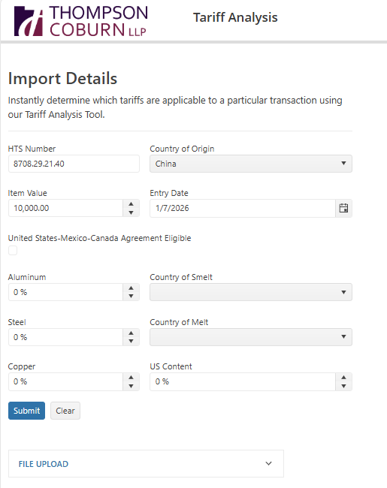
From Profile Raising to BD Lead Gen: Partnering with IT and our Practices

Slide 4
From Profile Raising to BD Lead Gen:
Partnering with IT and our Practices
The Challenge:
How to raise the profile of the firm on timely and interesting topics that highlight the expertise of the firm while also tying directly into business development strategy?
The Solution:
Identifying relevant expertise and timely opportunities
Partnering with the IT team and across our marketing and BD teams
Marketing Tech Stack as the backbone to deliver content and new business lead gen

Slide 5
Table Talk

Slide 6
Questions
How can you better tie together your existing marketing campaigns and business development pipelines?
How do you share the client intelligence across the firm/client teams?
How could the process be automated?
Who is identifying profile raising opportunities?
Who is tracking BD opportunities?
What AI/Automation tools to you use to track and what’s the output?
What could be better?

Slide 7

From Choppy Seas to Smooth Sailing
AI-Cleaned CRM for Events
Enhancing data quality through artificial intelligence solutions
Andrew Laver
January 23, 2026

Slide 8
Anchors Aweigh: Clean Data, Clear Results
Scenario & Solution

Slide 9

Challenges in CRM Data Management
Common Data Issues​
Duplicate contacts, outdated emails, and inconsistent fields hinder accurate CRM targeting and outreach.​
Impact on Efficiency​
Manual data cleanup wastes time and reduces marketing campaign and event invitation effectiveness.​
Reporting and ROI Challenges​
Poor data quality affects reporting accuracy, complicating ROI measurement and strategic planning.​
System Silos and Errors​
Multiple systems create data silos that increase error risks and complicate data management.​

Slide 10

AI-Driven Solutions for Data Cleansing
Automation of Data Cleansing​
AI tools automate deduplication, email validation, and data enrichment to reduce manual effort and increase accuracy.​
Machine Learning for Error Detection​
Machine learning algorithms identify data error patterns and apply corrective measures at scale effectively.​
Enhanced Personalization​
Accurate data enables personalized experiences, such as customized name badges for event attendees.​
Governance and Compliance​
AI supports governance through automated rules and human-in-the-loop quality assurance to minimize risk.​​

Slide 11
Chart Your Course: ROI & Collaboration
Impact & Playbook

Slide 12
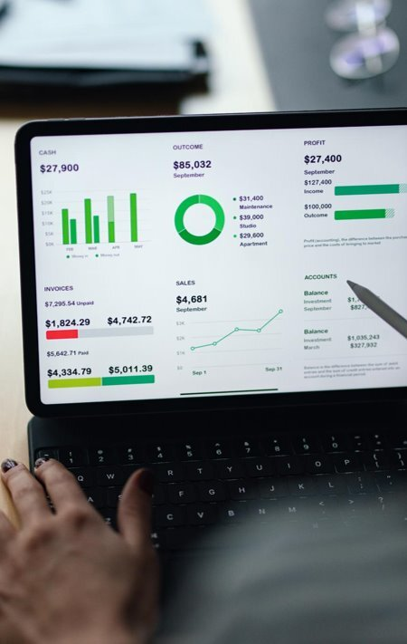
Measurable ROI from AI Integration
Improved Email Deliverability​
AI enhances email deliverability, increasing event attendance by reaching intended recipients without spam issues.​
Operational Efficiency Gains​
AI-driven data accuracy reduces manual cleanup, saving operational hours and allowing staff to focus on strategic tasks.​
Enhanced Revenue Generation​
Accurate attendee data improves post-event follow-up, positively impacting sales pipelines and revenue growth.​
Quantifiable Business Value​
Tracking attendance, cost reductions, and revenue metrics validates AI investments and demonstrates strategic marketing value.
Impact & Collaboration

Slide 13

Collaboration Playbook for BD and Events Teams
Collaboration Framework​​
A structured playbook outlines roles, responsibilities, and communication protocols for BD and events teams.
Alignment and Communication​
Weekly huddles promote alignment on event targets, attendee segmentation, and progress metrics.
Data Visibility and Insights​
Shared dashboards provide visibility into cleansed data and RSVP trends for proactive outreach adjustments.​
Technology Stack Integration​​
Integrated CRM, AI cleansing tools, email platforms, and badge printing enhance event workflows and personalization.
Impact & Collaboration

Slide 14
Docking the Ship: Measurable Impact

Slide 15

Measurable Impact
Once our data was clean and deliverability improved, we saw:
Email deliverability increased 44% after email platform switch
Attendance up 24% compared with past year comparable event
~17 hours/month saved in manual cleanup
$ still TBD from post-event follow-up and pipeline impact
M&BD team meet weekly to align targets and roles and share dashboards for cleansed segments and RSVP velocity.
Lawyer impact is tangible: better pre-event intel and faster post-event follow-up = more meaningful conversations and fewer missed touches.

Slide 16
Clean data doesn’t win headlines—but it compounds everything you do in BD

Slide 17
Table Talk

Slide 18
Questions
Table Talk
What’s the biggest barrier you’ve faced in using AI for CRM—technology, governance, or cultural adoption?
Do you trust AI to make changes in your CRM autonomously, or do you keep a human-in-the-loop?
If your CRM were 99% accurate tomorrow, what would that unlock for your BD and marketing teams?

Slide 19
Strategic Intelligence
Using SI and AI to support client growth
Zena Applebaum, Harbor Global
January 23, 2026

Slide 20



Strategic Growth
A paradigm for strategic growth begins with market demand and an understanding of how practice groups align with demand. From there, you need to understand competitors to each practice so the practice can identify what differentiates it in the market. It is these areas of differentiation that enable greater client and market share. The challenge for law firms is that this information needs to be up-to-date, and this process needs to be repeated to account for differences in each practice and shifts in the market.
Growth Strategy
MARKET DEMAND
COMPETITIVE LANDSCAPE
PRACTICE EXPERTISE
COMPETITIVE ADVANTAGE
Identify the target market and its demand for expertise, ongoing needs, and unique challenges.
Determine competitors at the practice level. Understand their services and strengths.
Identify the unique expertise of the practice against the competitive landscape.
Align market demand with practice expertise to determine how to differentiate the practice in the market.
© Harbor Global, LLC

Slide 21
Capitalizing on Market Demand
Optimizing MarTech Stack
Strategic Advice
Firm business professionals collaborate with attorneys to identify opportunities and convert them to matters.
Law firm business professionals need to focus on connecting firm strategy with market intelligence to deliver strategic advice that uncovers and drives new opportunities.
Business Need
Demand for services across industries, white space analysis across clients, etc.
To deliver expert analysis, business professionals need on-demand access to this information. Currently, it's assembled manually, which is time-consuming and immediately outdated.
Data
Attorney Experience
Matters
Clients
Prospects
Referrers
Companies
Relationships
This is the data required to support each of these business needs. It should be readily accessible, reliable, and actionable.
Marketing Technology
Firm Website
Experience
CRM
ERM
These are the data source systems that make up the Marketing technology stack.
© Harbor Global, LLC

Slide 22
AI-powered key client programs: Weekly Litigation Monitoring
AI-powered key client programs
The Challenge
A large, multi-national firm wanted to position itself as a key leader in the advertising litigation space and differentiate itself from its competitors. It also wanted to find ways to regularly touch base with its largest and most important clients, by incorporating technology given tight resources.
Solution
A third party outsourced AI-powered, human-overseen weekly summary of advertising litigation that is pushed to firm clients via a dedicated app. The content + analysis is embedded into the firm’s processes, reaching more than 1,500 readers a month. Seamlessly blending tech with intelligence and no over burdening existing resources.

Slide 23
AI-powered key client programs: Thought Leadership
AI-powered key client programs
The Challenge
A large American firm wanted to produce regular thought leadership for two key clients in very different industries.
Solution
Create two separate thought leadership briefings for that are pushed to the firm’s biggest clients, solidifying the firm’s authority and credibility in two highly competitive sectors.
The firm provides the service as a “great touchpoint for clients” and are actively involved in content creation and messaging, partnering with a third party analysts to grow engagement, track ROI and other metrics.

Slide 24
AI-powered key client programs: Where to Start?
AI-powered key client programs
The Challenge
A large, international firm was interested in monitoring its clients but wasn’t sure where to begin.
Solution
Engage Harbor to use its advanced tech + human input to help clients track/monitor their key clients and prospects, flagging pertinent touchpoints and milestones, giving the firm action items for their most important clients.
Harbor also leverages AI for recurring intelligence requests with the same client, leveraging it to assign work, support analysts, and for quality control where appropriate.
Harbor seamlessly rides along side the firm unseen as an extra pair of hands/ears/eyes monitoring clients and cutting through the noise.

Slide 25
Activating Market Opportunity
ILLUSTRATIVE
Energy & Utilities
Current Energy & Utility Clients
Client Intelligence
According to Harbor’s 2024 Law Department Survey companies …
Research of top 20** active E&U Firm clients for non-Reg matters reveal the following companies may have current Regulatory needs (see Report for specifics):
Non-Reg Practice Areas (top 3)*
894 Clients
126 Active Clients Non-Reg Matters
NextEra Energy
Southern Company
Dominion Energy
Duke Energy
American Electric Power
Consolidate Energy
78%
anticipate an increase in Regulatory work in 2025
Transactional
Litigation
Environmental
Regulatory work in E&U by the numbers
Competitor Analysis
High-Level Suggested GTM Plan
Research of top 20** active E&U firm clients for non-Reg matters signal that the following firms may be providing Regulatory services to these clients:
1
xxx
$8.4M
Kirkland & Ellis
Latham & Watkins
Sidley Austin
Skadden
Covington
Morgan & Lewis
Ropes & Gray
Arnold & Porter
Davis Polk
Mayer Brown
2
xxx
$9.8M
3
xxx
$3.2M
4
xxx
REVENUE
© Harbor Global, LLC
*See Report for relationship mapping
**By company revenue

Slide 26
Operationalizing Market Opportunity
Optimizing MarTech Stack
Considerations
Research & Analysis
Strategic Advice
What should a GTM plan encompass to capitalize on the growing demand for Regulatory needs for Energy & Utilities companies?
Harbor’s Law Department Survey Results Thomson Reuters Institute Reports
Business Need
The firm needs to strategically grow its Regulatory practice.
Data
 |  | Firm Data | Third-Party Sources
What is our specific expertise in that landscape? |  | Experience
Which clients does the Firm currently have in the Energy & Utilities industry? |  | CRM (clients & prospects) Finance System | N/A
What services are we currently providing those clients? |  | Experience Finance System
Marketing Technology
If we are not providing Regulatory services to specific clients, who is? (Competitive Intelligence) |  |  | LexMachina, DocketAlarm, PitchBook, News/client Alerts, statenet, Intelligize, Westlaw, Lexis
Which clients have active matters with those clients and who’s the relationship partners? |  | Experience Finance System
© Harbor Global, LLC

Slide 27
Table Talk

Slide 28
Questions
Table Talk
What intelligence do you track today?
Who is tracking?
What AI/Automation tools to you use to track and what’s the output?
How do you share the client intelligence across the firm/client teams?
Is the process manual or automated today?
What could be better?

Slide 29
Wrap Up

Slide 30
Leaders need to provide a vision for their teams that is broader than the tools. Tools are a how, not a why.

