Slide 1
Casting a Wider Net
Rethinking Demand Generation for Mid-Law Business Development Teams
January 21, 2026
1:00 – 2:15 EST

Slide 2

Casting a Wider Net: Rethinking Demand Generation for Mid-Law Business Development Teams
While large law firms may have dedicated teams for each stage of the sales funnel, mid-sized firms often rely on leaner, more flexible business development resources. Given this, it is imperative that mid-sized firms build efficient and effective demand generation programs to support BDRs with existing infrastructure. Within resource constraints, how can firms implement scalable outreach frameworks that drive visibility and credibility with prospective clients? Join us as we explore smart segmentation strategies, hybrid automation-personalization tactics, and CRM-enabled targeting that create high-value opportunities without overwhelming the firm’s resources.
Moderator:
Robin Gerard, Chief Marketing Officer, Stradling Yocca Carlson & Rauth LLP
Panelists:
Julie Amos, Chief Marketing and Business Development Officer, Hinshaw & Culbertson LLP
Heather Morse, Chief Business Development Officer, McGlinchey Stafford PLLC
Ashraf Lakhani, Chief Marketing and Business Development Officer, Porter Hedges LLP

Slide 3
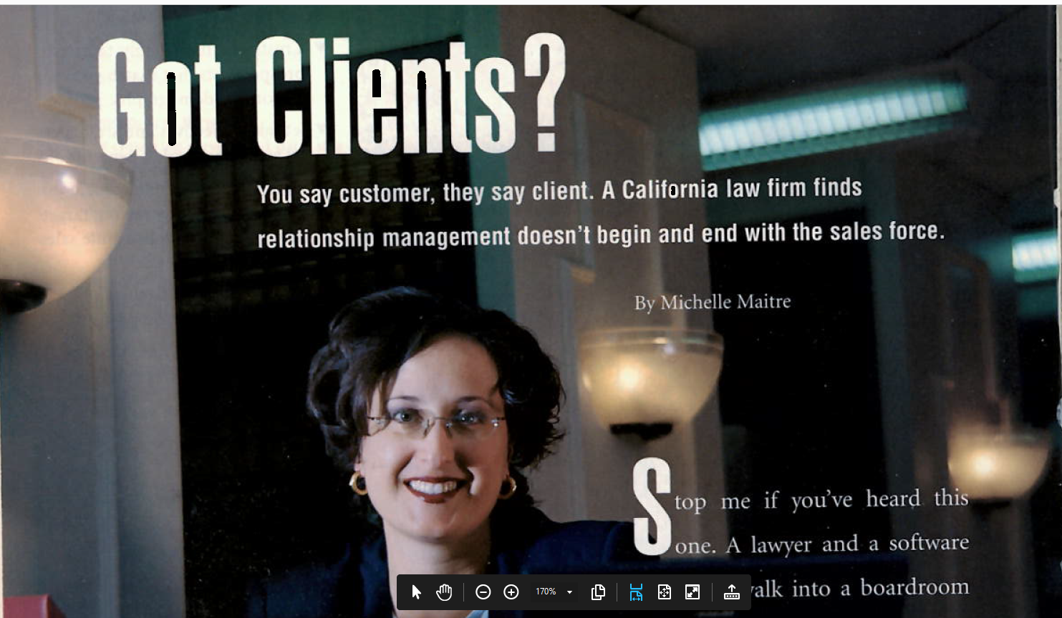
Guess Who Graced The Cover of CRM Magazine in 2000?

Slide 4
What Are We Talking About Today?
Smart segmentation strategy:
  This tactic uses data, AI, and analytics to group clients and prospects by behaviors, preferences, and interactions (not just basic demographics) to deliver relevant, personalized experiences, and messages that resonate, improving engagement, conversions, and loyalty.
Hybrid automation-personalization tactics
  These tactics blend AI-driven efficiency and data insights with human creativity and empathy to deliver highly relevant, individualized client and prospect experiences at scale, automating routine tasks while injecting strategic, emotional touches for deeper engagement and better results. For example, this could mean using automation for speed (like triggering emails) but having humans refine messaging (storytelling, branding).
CRM-enabled targeting:
  This tactic uses data from a CRM system (contact info, emails, matter history, website behavior, social media engagement, industry sector, news) to create highly personalized campaigns and enable lawyer BD outreach across specific customer segments.

Slide 5
Polling Instructions
Please take out your phone and navigate to our session: “Casting a Wider Net.”
Select “Participate in Live Poll” on the session screen.
Enter your answer.
Once the poll closes, results will display on your phone.

Slide 6
Polling Question 1
What is the size of your firm?
1-50 attorneys
51-100 attorneys
101-200 attorneys
201-500 attorneys
500+

Slide 7
Polling Question 2
How many offices does your firm have?
1 office
2-5 offices
6-10 offices
More than 10 offices

Slide 8
Polling Question 3
What is the size of your BD & marketing team?
1-5 people
5-10 people
10-15 people
15-20 people
More than 20 people

Slide 9
Polling Question 4
What CRM system are you using?
Intapp Deal Cloud
Interaction
Nexl
Salesforce
Peppermint
TreAI
Other
We don’t have a CRM

Slide 10
Polling Question 5
How long have you been in legal marketing?
1-5 years
6-10 years
11-15 years
More than 20 years

Slide 11
Polling Question 6
Which of the following tactics best describes your current approach?
Smart segmentation
Hybrid automation-personalization tactics
CRM enabled targeting
We are not using any of these at present.

Slide 12
Smart Segmentation Strategies

Slide 13
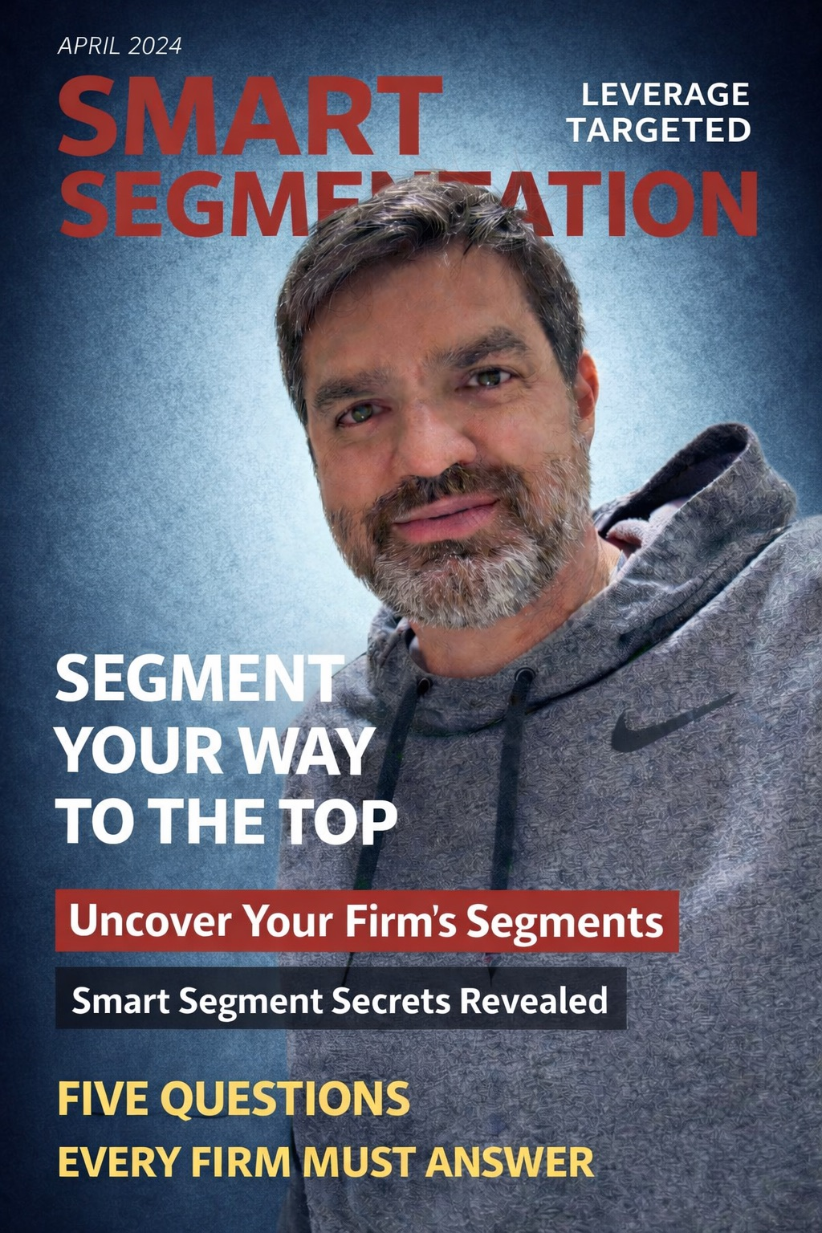

Slide 14
Uncover Your Firm’s Segments
A real segment is a group of buyers who behave similarly — they have similar triggers, expectations, and buying paths.

Slide 15
Smart Segment Secrets Revealed
Segmentation isn’t about marketing—it’s about deciding where not to spend time.

Slide 16
Five Questions Every Firm Must Answer
The roadmap to establishing segments that have traction, buy-in, and the ability to stand the test of time.

Slide 17
Five Questions
What handful of practices truly drive revenue at the firm?
What triggers a buyer to need the firm’s services now?
Who inside the firm can open doors - today?
How do you segment your segments?
How do you measure success of your segmentation?

Slide 18
Segmentation isn’t about reaching more people — it’s about reaching the right people in a way your firm can actually sustain.

Slide 19
Hybrid Automation-Personalization Tactics

Slide 20
Delete.
Delete.
Delete.
. . . Pause.

Slide 22
-Harvard Business School professor Michael Porter
“The essence of strategy is choosing what not to do.”

Slide 23
CRM-Enabled Targeting

Slide 24
CRM as a Strategic Asset

Slide 25
Targeting Without Overload

Slide 26
Polling Question 7
What is the biggest barrier to CRM-driven demand generation at your firm?
Lawyer adoption
Data quality
Lack of targeting strategy
Limited BD resources
Technology limitations
Other

Slide 27
Lawyer Engagement and Execution

