Slide 1

Steering by Starlight
Exploring Smarter Cross-Selling Strategies

Slide 2
The average firm delivers 1.8 practice areas, but clients have 4 major legal needs.
BTI Consulting

Slide 3
Clients working with 3+ practice areas are 7x more likely to stay.
Revenue triples when expanding to two practices.
Dr Heidi Gardner, Harvard Law School

Slide 4
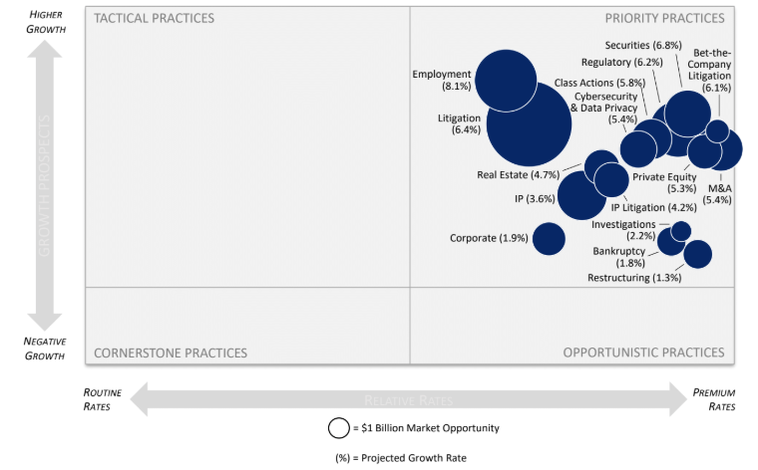
BTI’s Practice Roadmap
Analysis of legal practices by growth, relative rates, and market size
BTI Market Outlook & Client Service Review 2026

Slide 5
The cross-selling opportunity
The power of cross-selling
To what extent do you agree or disagree that “Cross-selling is the biggest opportunity to grow law firm revenue.”
75%
To what extent do you agree or disagree that “Cross-selling is the biggest opportunity to grow”?

Slide 6
The cross-selling opportunity
How much could you increase revenue if
cross-selling opportunities were maximized?
Passle, 2025, Cross-selling and AI in legal marketing report

Slide 7
Keys to Making Collaboration Systematic
Start with Data: Quantify your firm’s collaboration opportunities using industry research, experience data, whitespace analysis, client feedback, and CRM data.
Map Client Needs: Identify where client needs intersect with multiple practice areas. Work with partners to articulate multi-practice solutions. Don’t forget opportunities that arise through lateral hiring or succession planning.
Break Down Silos: Host regular cross-practice strategy sessions. Encourage partners to engage in collaborative activities across a wide range of firm activities.
Align Incentives: Advocate for compensation models that reward team-based origination and delivery.
Pilot, Measure, Repeat: Launch small-scale collaboration pilots with clear KPIs. Track not only lagging metrics like revenue but also leading metrics like multi-practice pitches and joint client planning sessions.

