Slide 1


Slide 2
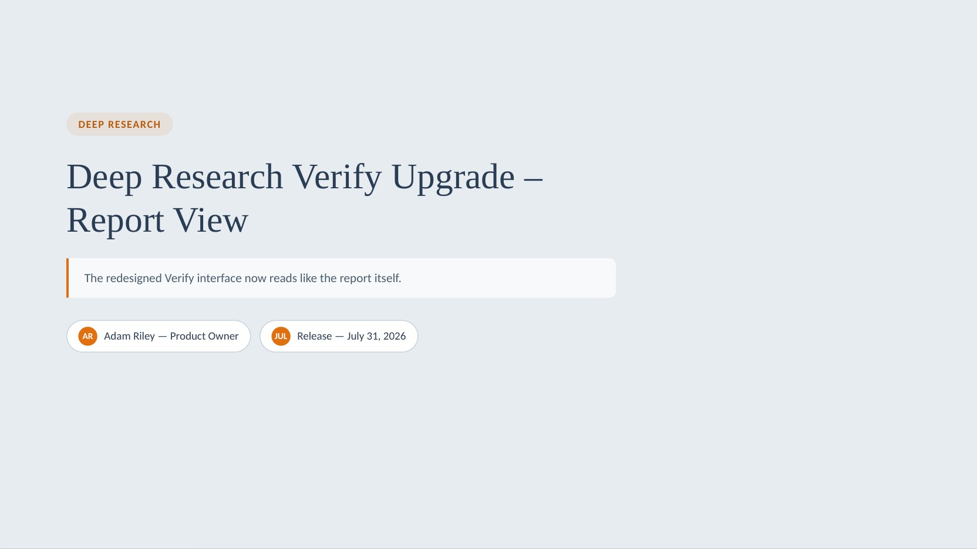

Slide 3

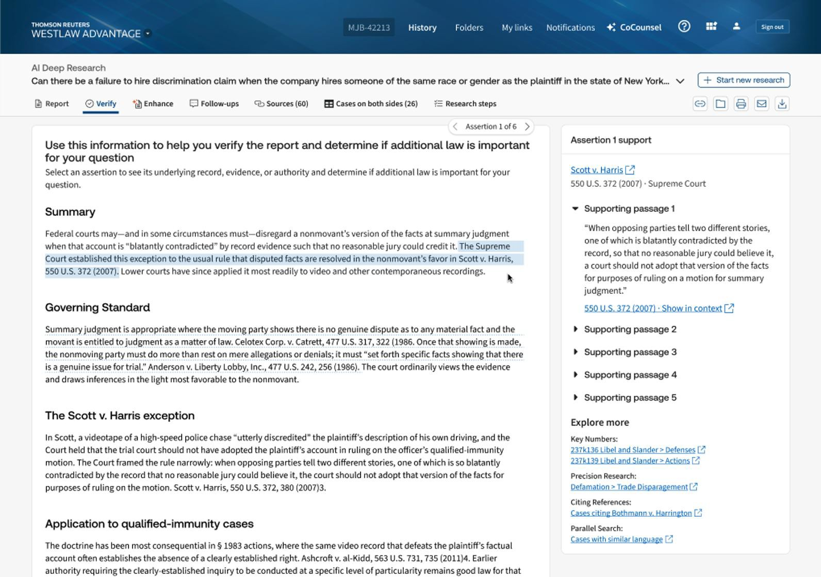
Improved Verify Experience
V E R I F Y · R E P O R T V I E W
The redesigned Verify interface now reads like the report itself. Instead of a table of assertions, users move through the research the same way they'd read it.
Selecting any part of the report opens a dedicated support panel showing the underlying cited authority, verbatim supporting passages, and Explore More links, so the evidence sits right alongside the text it backs. The result is a faster, more intuitive path from reading aa assertion to verifying it with no context-switching, no hunting for sources.
Note: Customers will still receive the table view when delivering or downloading Verify

Slide 4



New Navigation –
Same information
V E R I F Y · R E P O R T V I E W
On the Verify tab, click on the report or use the step navigator at the top
Click on any assertion and see the related Verify support and additional information on the right.
Supporting passages /
Authority Found
Expand verbatim passages that ground the assertion.
Cited authority
Jump to the case or source, e.g. Scott v. Harris.
Explore more
Key Numbers, Precision Research & related searches.

